Slide 1



Mapua MCM
2025
KITAKO
PRESENTATION
presentation by
01
MWorks

Slide 2





Mapua MCM
2025
ABOUT
US
KITA KO is a user-friendly stock tracking app designed to help small business owners, especially sari-sari store operators, monitor their inventory and income with ease. The app allows users to record stock levels, track restocking activities, and manage daily earnings all in one platform. With its simple interface and practical features, KITA KO empowers users to stay organized, make informed business decisions, and gain better control over their store operations.
02

Slide 3



MWorks
2025
PROJECT OBJECTIVES
Kita Ko aims to support small retail businesses by providing an easy-to-use digital tool for tracking inventory and income, helping improve efficiency, reduce losses, and boost business growth.
03

Slide 4



MWorks
2024
MOTIVATION
Many small business owners, especially sari-sari store operators, struggle with manually tracking inventory and income, leading to inefficiencies, stockouts, or overstocking. There’s a lack of accessible tools tailored to their needs.
04

Slide 5



Studio Shodwe
2025
TOP REQUIREMENTS
From our user research, we learned that users want a simple interface, the ability to record sales and expenses quickly, real-time inventory tracking, and summaries of daily income and restocking needs.
05

Slide 6

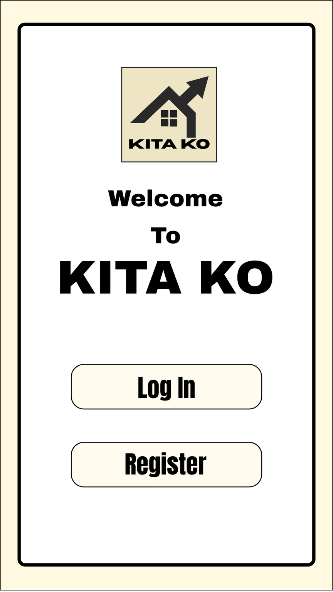
MWorks
2025
DESIGN
Kita Ko features a clean, mobile-friendly interface where users can add products, monitor stock levels, track earnings, and get alerts when items are low. It’s designed for speed and ease of use, even with limited digital skills.
06

Slide 7
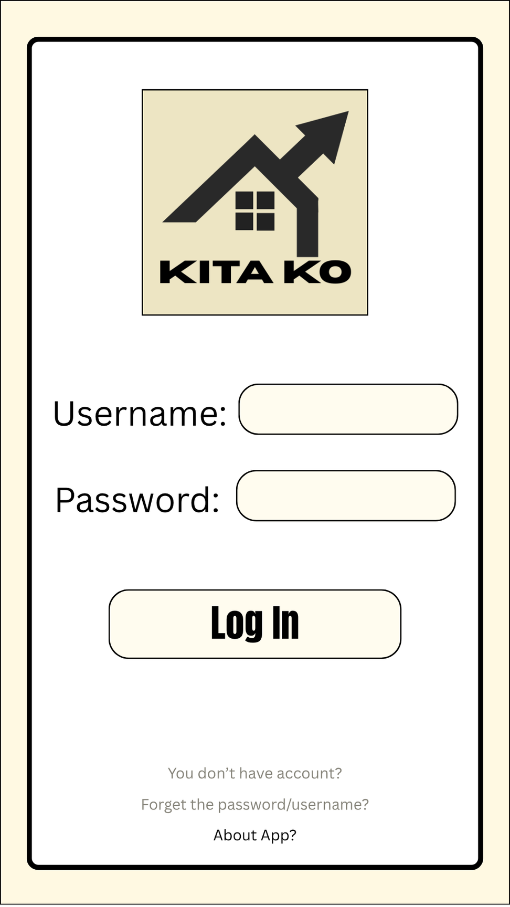
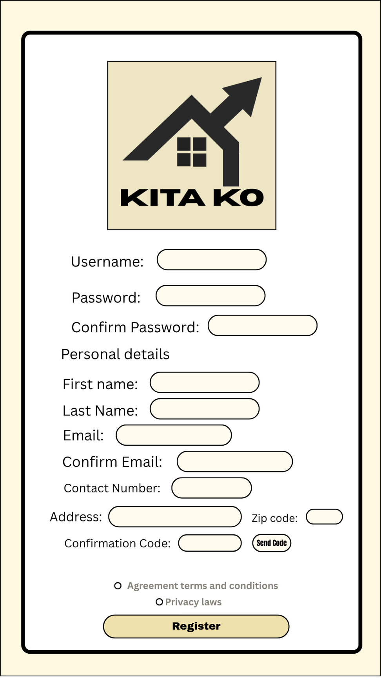
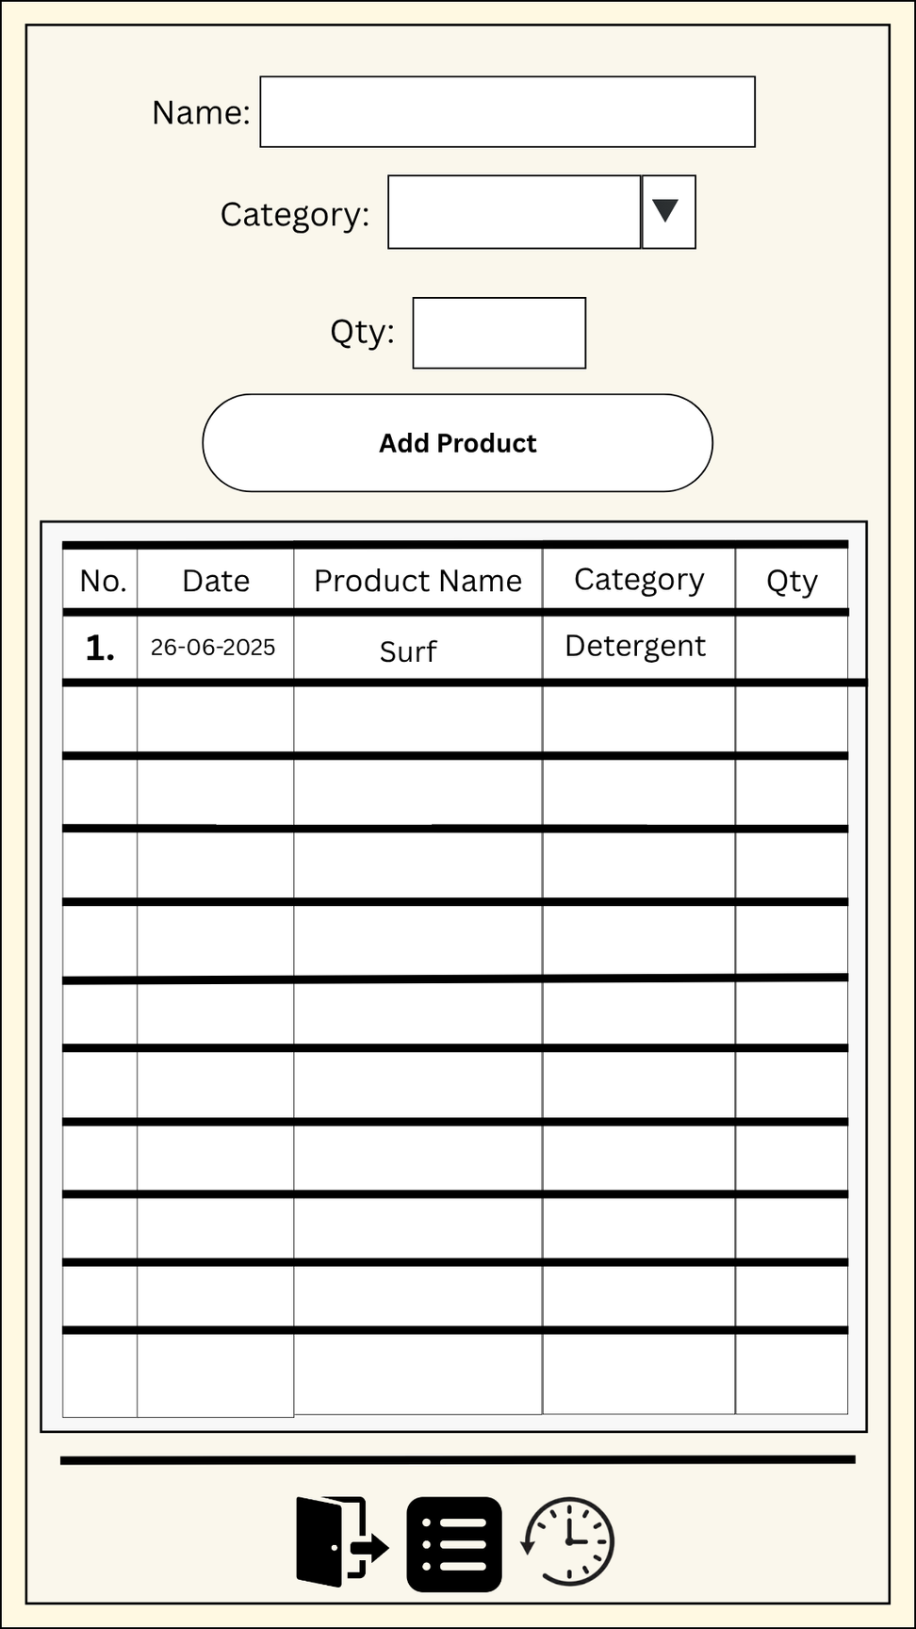
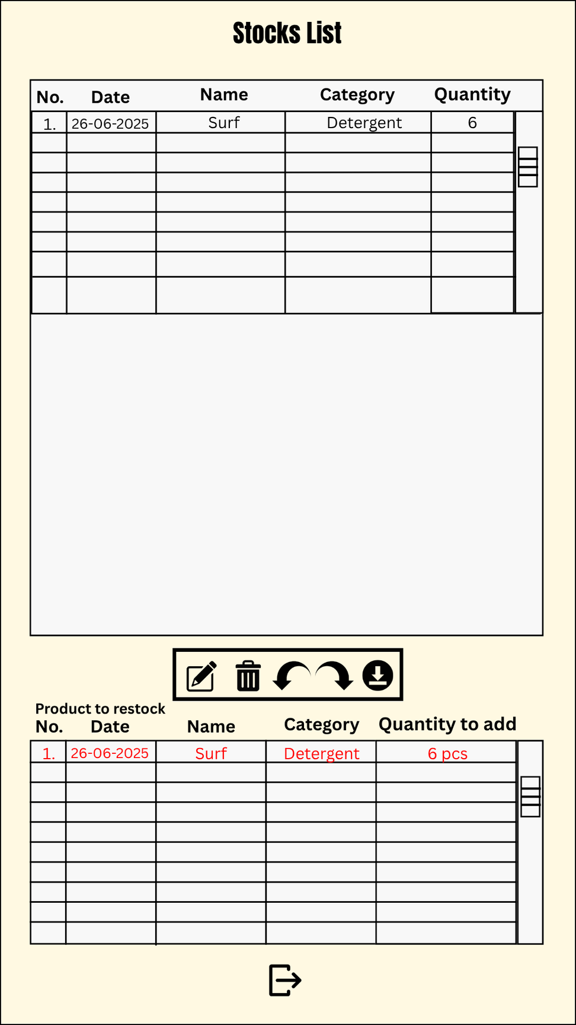
MWorks
2025
DESIGN
07

Slide 8
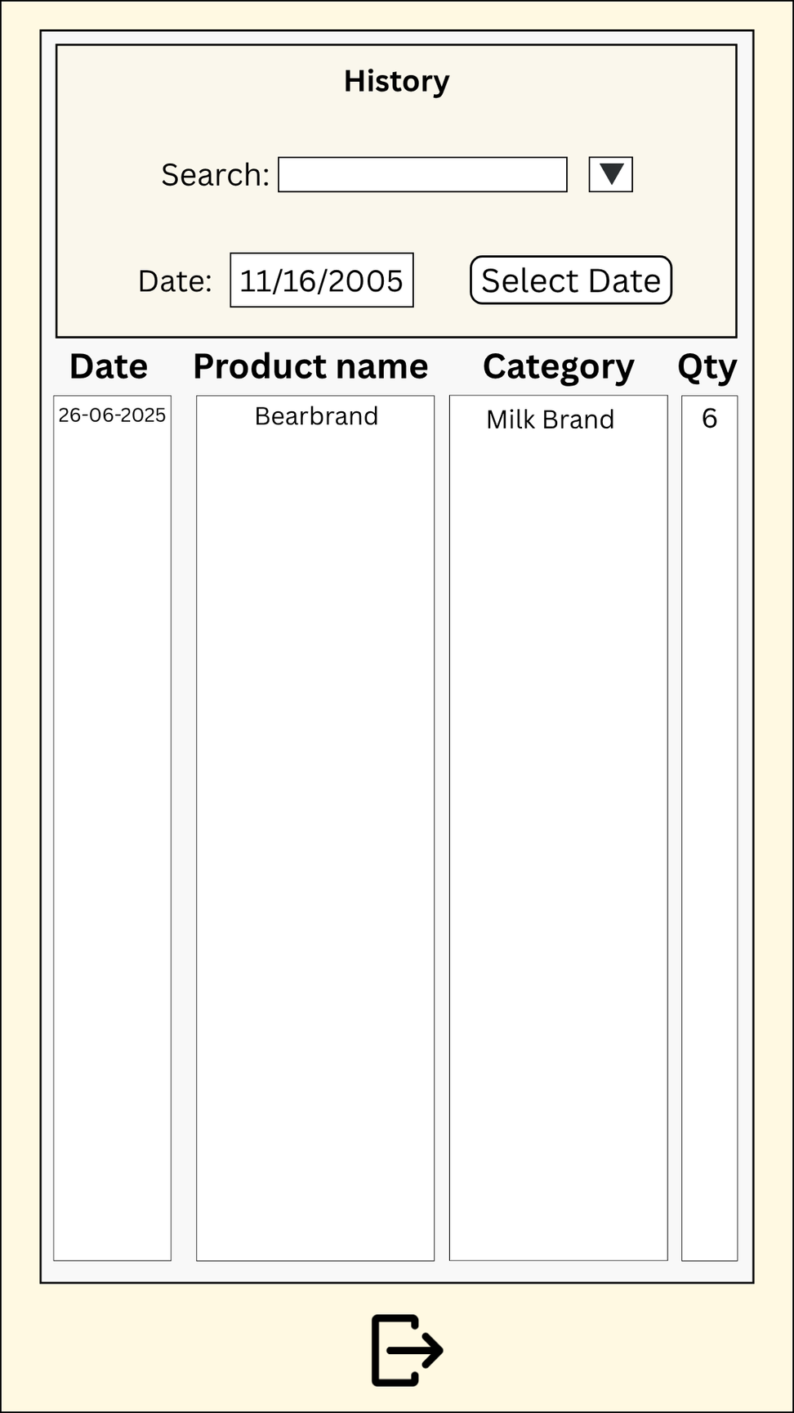
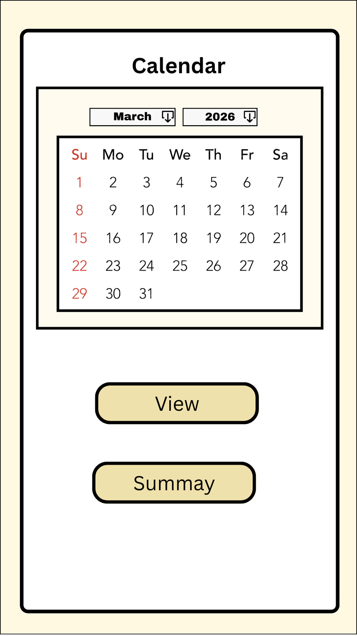
MWorks
2025
Prototype Development Tool
We used Canva to design the UI prototype of the Kita Ko app. Canva allowed us to create a clean, organized, and user-friendly layout that clearly represents the app’s core features such as inventory input, stock monitoring, and restock alerts.
DESIGN
08

Slide 9
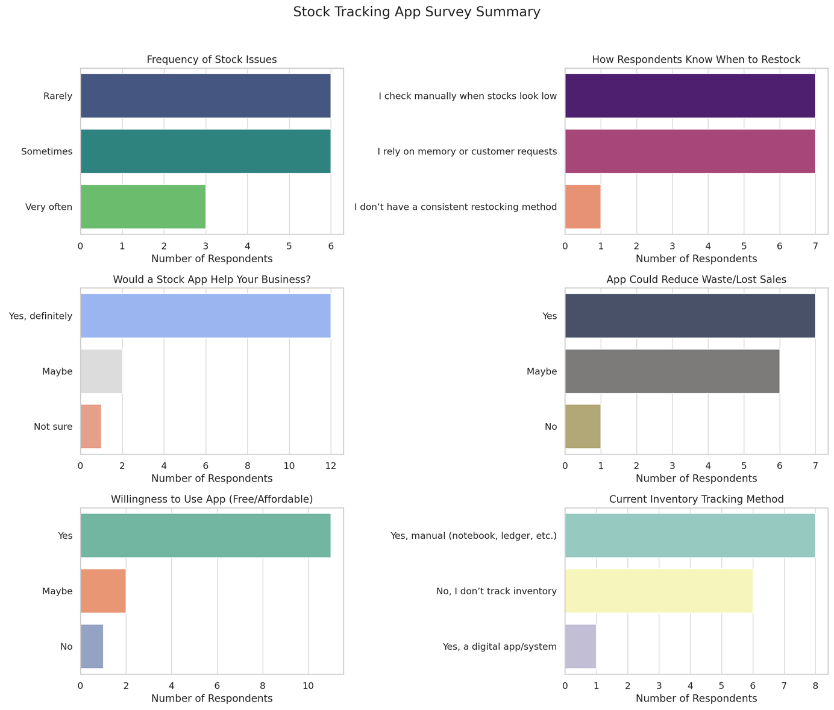
MWorks
2025
EVALUATION
We tested the prototype with small business owners and student users. Most found it easy to navigate and appreciated the daily summaries and inventory alerts. Minor suggestions included adding a Notification and cloud backup.
09

Slide 10


MWorks
2025
CONCLUSION
With more time, we would add features like syncing across multiple devices and visual sales reports. We would also expand user testing to include a wider range of small business owners, especially those in rural areas.
10

